Slide 1
Cookify
Project Contributors:
Hashir Owais
Nathan Okoh
Simran Gahra
Week 13
Nov. 26, 2024
Software Engineering Management (ENSE 374)

Slide 2
Agenda
Introduction
Problem Definition
Design Requirements
Solutions
Project Management
Conclusion and Future Work

Slide 3
Introduction
Background
Busy lifestyles make it challenging for people to cook at home, leading to poor nutrition, higher expenses, and significant food waste. These issues contribute to chronic health problems and environmental harm.
Rationale
There is a clear need for a tool that helps users save time, plan cost-effective meals, and reduce waste. Our project addresses this by providing a platform that turns groceries into quick, nutritious meals, promoting healthier habits and sustainability.

Slide 4
Problem Definition
The problem we are trying to solve is the challenge busy individuals face in preparing nutritious home-cooked meals due to time constraints and demanding schedules.
In Canada, nearly 60% of food produced is wasted annually, with households contributing over 20% of this waste, costing the average Canadian household approximately $1,300 per year (Second Harvest, 2022).
Around 29% of Canadians eat out at least once a day, which often leads to poor nutrition and higher expenses (Statistics Canada, 2021).

Slide 5
Design Requirements
Goals & Objectives
To create an application that makes cooking accessible and sustainable by suggesting recipes based on user-input ingredients. A user-friendly and visually intuitive design ensures tailored for young adults and single professionals.
Account creation for user personalization.
Saved Recipes for user practicality and ease of use.

Slide 6
Design Requirements
Constraints
Time Constraints: The project had a limited timeline for design, development, and testing phases
Technical Experience: Limited experience in handling integrating external APIs and managing a hybrid database.
Learning Curve: Team members faced a learning curve in implementing key components such as API integrations, database management, and frontend/backend interactions.

Slide 7
Solution 1 - Static Webpage
Design: A single static webpage with a basic input field for ingredients.
The page matches user inputs with predefined list of recipes
using simple keyword matching.
Implementation:
HTML and CSS is to be used for the interface.
JavaScript will handle the logic for keyword-base ingredient matching.
No backend or database integration will be included.

Slide 8
Solution 2 – DB & External API Integration
Design: A web application that combines an external API for recipe data retrieval with a minimal backend database for storing user specific data like saved recipes but lacks filtering options. Implementation:
HTML, CSS, bootstrap and minimal JavaScript for rendering recipe results fetched from the API.
Node.js with a lightweight database like SQL to store saved recipes.
API is integrated to fetch recipes in real-time from an external API but supports only simple ingredient-based matching.

Slide 9
Solution 3 – Hybrid Solution Approach
Design: A hybrid web application with an external API for real-time
recipe data and a local database for storing user preferences,
saved recipes, and dietary restrictions. The application provides a dynamic and personalized user experience.
Implementation:
HTML, CSS, bootstrap, ejs and JavaScript for a responsive interface.
Node.js for API integration and database connectivity.
OpenAI API Fetches real-time recipe data dynamically.
MongoDB for saving user preferences and recipes.
Mongoose Passport for secure login and session handling.

Slide 10
Solutions Comparison:
Features | Static Webpage (Sol. 1) | Database & API Integration (Sol. 2) | Hybrid Approach (Sol. 3)
Ingredient Matching | Low | Moderate | High
User Personalization | Minimal | Moderate | High
Data Scalability | Low | Moderate | High
Ease of Implementation | High | Moderate | Low
Real-Time Access | No | Yes & No | Yes

Slide 11
Web-Application DEMO:

Slide 12
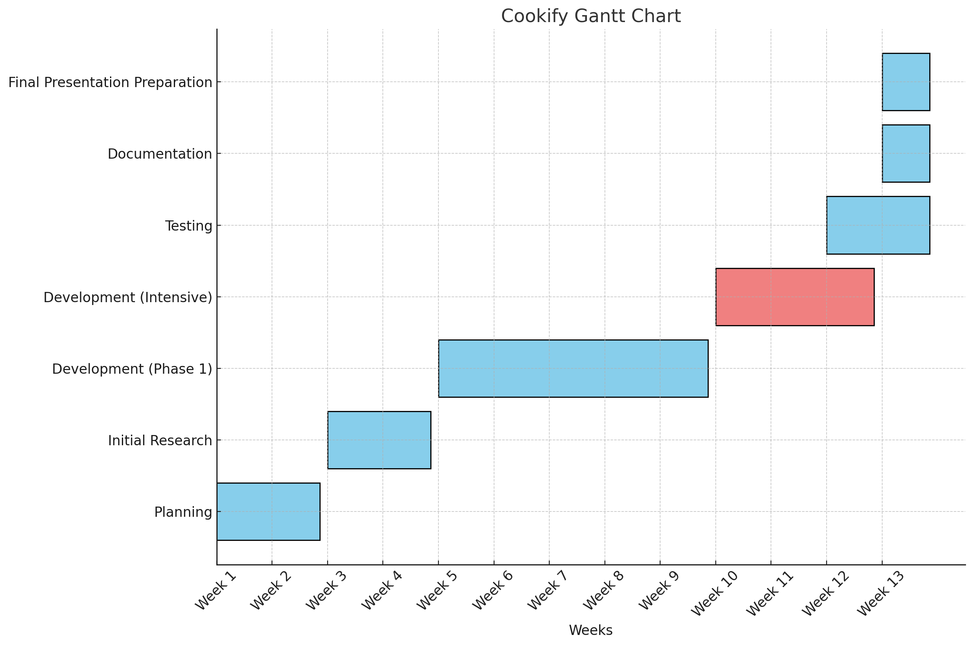
Project Management

Slide 13
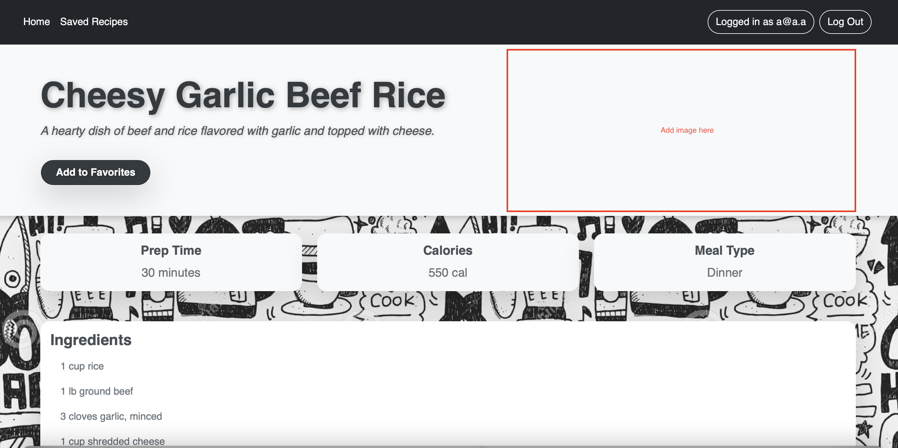
Future Plans
Add Images for Recipes: Enhance the user experience by displaying images alongside generated recipes to make the interface more visually appealing and engaging.

Slide 14
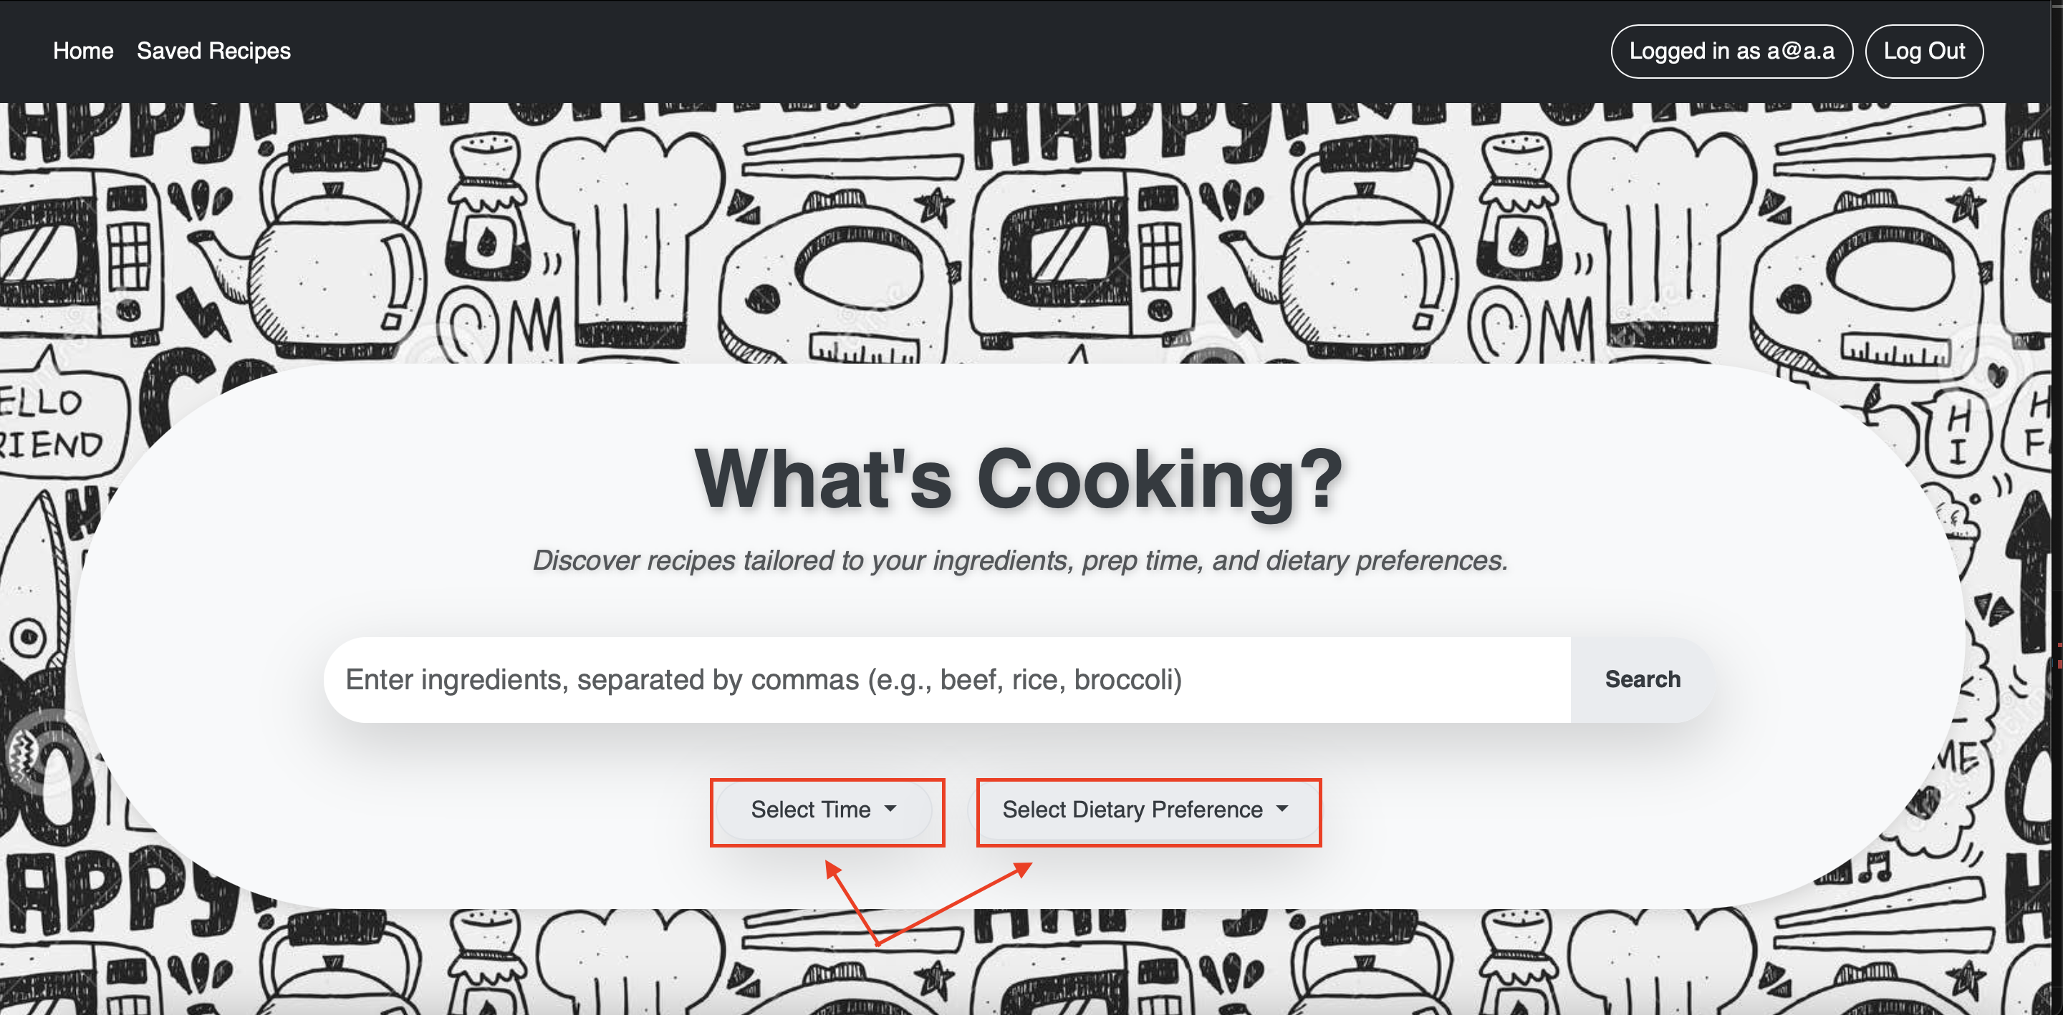
Future Plans
Customizable Categories: Allow users to generate recipe categories based on their preferences, such as "Quick Meals," "Easy Difficulty" or "Budget-Friendly.".

Slide 15
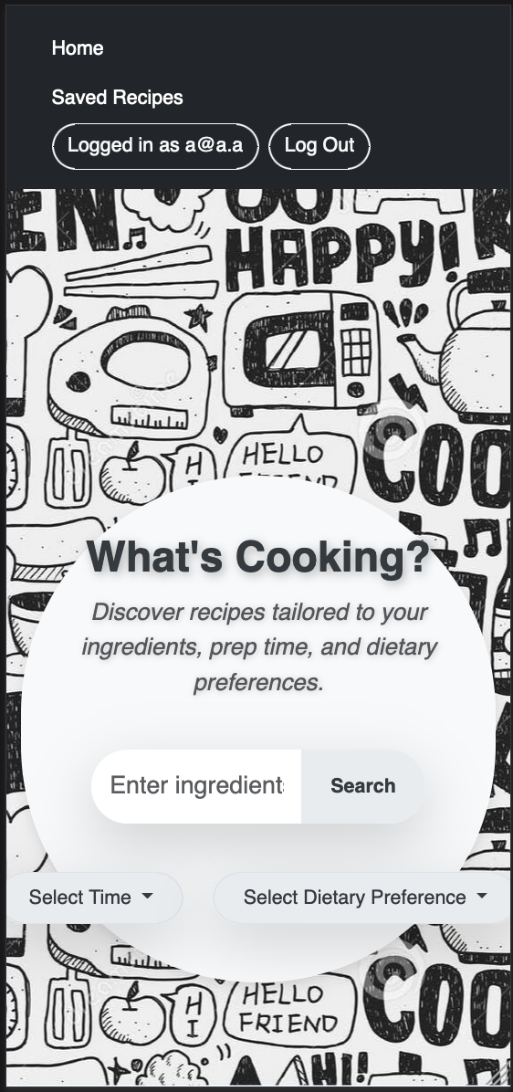
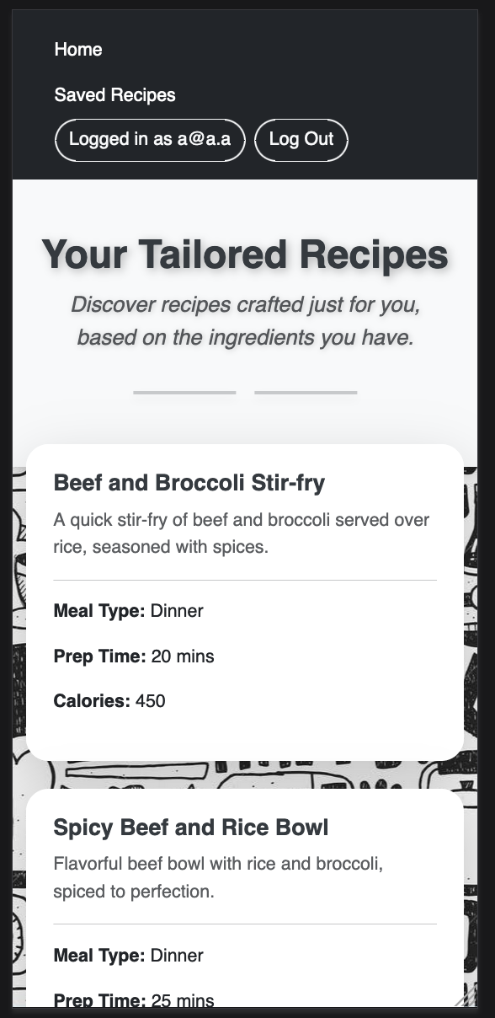
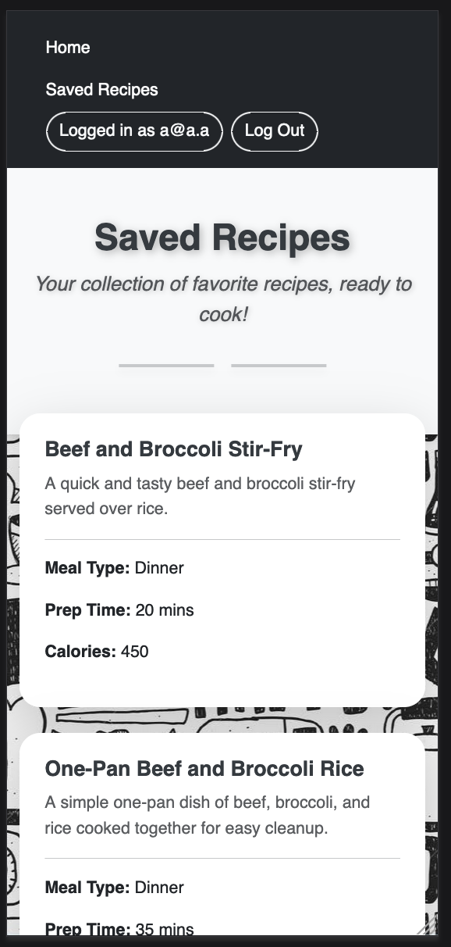
Future Plans
Native Mobile App Support: Develop a native mobile version of Cookify to enhance accessibility and user convenience, allowing seamless use on smartphones and tablets.

Slide 16
Conclusion
Successfully developed a functional recipe generation
Application
Implemented using EJS, MongoDB, Express.js, OpenAI API
and Bootstrap
Simplifies meal preparation by generating recipes based on
user-provided ingredients, making cooking more accessible
and efficient.

Slide 17
Thank you!
Any questions?

